Slide 1
Introduction to Regional Anesthesia CA-1 Lecture
Meredith Kan, MD
9/26/17

Slide 2
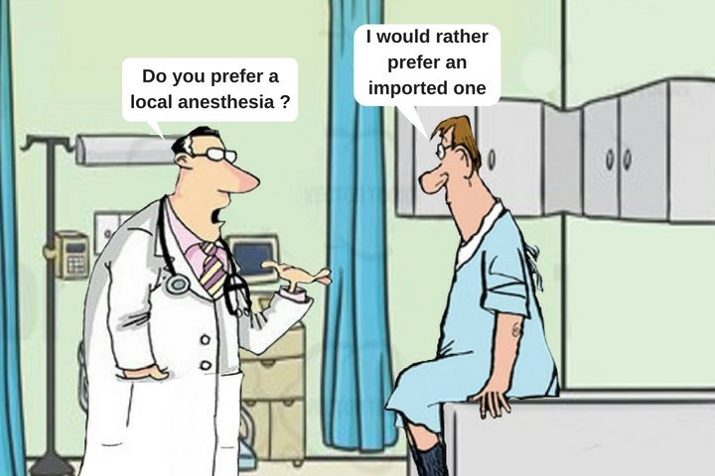
What is Regional Anesthesia?
Application of local anesthetic to nerves to temporarily block sensation to a region of the body (neuraxial and peripheral nerve blocks)

Slide 3
What does it do?
Reduces sensation – reduces need for other forms of anesthesia and analgesia, depending on type of block and type of local anesthetic
in place of GA, supplement GA, and/or for post-op pain
What purpose can they serve:
Reduced the amount of other anesthetics, or completely eliminate need for GA
Reduce the amount of post-op pain on POD 0 and beyond (if catheter is used)
Components of regional anesthesia:
-understanding when and how RA can help, patient selection
-equipment – U/S
-LA
Types of blocks (full body diagram)
Types of local anesthetics – what is a local anesthetic. Types. Properties. How do we choose between one and another
Neuraxial blocks
Spinal
Epidural
Peripheral Nerve blocks
SS – short acting (3-6 hrs) long acting (8-18 hrs)
Catheter (2-4 days)

Slide 4
Why Regional Anesthesia?
Alternative to GA
Reduce opioids
Reduce PONV
Improve pain control
Facilitate readiness for discharge to home

Slide 5
Types of Regional Anesthesia
Neuraxial blocks (spinal, epidural)
Peripheral Nerve blocks
Brachial Plexus blocks
Femoral & Saphenous nerve blocks
Sciatic Nerve blocks
Truncal Blocks (TAP blocks, paravertebral blocks)

Slide 6
Spinal Block (SAB) vs. Epidural

Slide 7
Epidural Role in Surgery

Slide 8
Epidural Procedure
Anatomic Landmarks
Technique

Slide 9
Epidural Procedure

Slide 10
Epidural Procedure

Slide 11
Question Answers
Skin
Subcutaneous Fat
Supraspinous ligament
Interspinous Ligament
Ligamentum Flavum

Slide 12
Epidural - Steps
Consent
Positioning and Monitors
Sterile Prep & Drape
Skin Wheal
Advance tuohy needle/attached LOR syringe until loss of resistance is encountered
Advance catheter through tuohy ~5 cm past tip
Secure catheter
Test dose

Slide 13
Epidural catheter placement

Slide 14
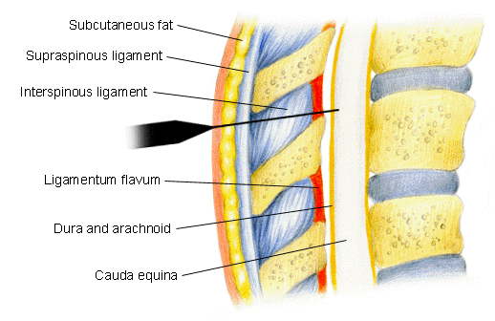
Spinal aka Subarachnoid Block (SAB)

Slide 15
Spinal vs Epidural

Slide 16
Spinal - steps
Consent
Positioning and Monitors
Sterile Prep & Drape
Skin Wheal
Advance spinal needle until “pop” felt or if appropriate depth achieved, check for CSF
Administer local anesthetic dose

Slide 17
SAB/Epidural Risks
Hypotension
Infection (epidural abscess)
Bleeding (epidural/subdural hematoma)
Post-Dural Puncture Headache (PDPH)
Unintentional intrathecal or intravascular injection
Block failure

Slide 18
SAB/Epidural Contraindications
Risks and benefits must be considered on an individual patient basis.
Absolute Contraindications:
Patient refusal
Infection at site of injection
Hypovolemia
Coagulopathy
Increased intracranial pressure
Indeterminate neurological disease
Severe spinal stenosis @ site of spinal injection (severe lumbar spinal stenosis)
Relative Contraindications:
Infection distant from site of injection
Unknown length of surgery (if spinal is primary anesthetic).
Difficulty communicating with patient, patient unable to cooperate
Cardiac disease that will not tolerate acute reduction of SVR (i.e. severe AS)

Slide 19
Peripheral nerve blocks

Slide 20
What are Nerve Blocks?
Delivery of local anesthetic around specific nerve or group of nerves to reduce sensation to desired region of the body
Motor and proprioception are also blocked
Single shot (SS) or catheter
Ultrasound-guided or nerve stimulation
Follow-up

Slide 21
Nerve Blocks – overview
Introduction to Regional Service @ Stanford
Types of common Nerve blocks
Indications/Contraindications
Logistical issues

Slide 22
Regional Team
Team approach to planning, nerve block placement and follow-up
Dedicated team outside of the OR to focus on efficient, effective and appropriate block placement
Daily regional plan email – fellows
Communication
Busy AM – lend a hand when you can!

Slide 23
Regional Anesthesia Rotation
Learn functional anatomy, sonoanatomy
Appropriate patient selection
Appropriate block type/local anesthetic selection
Understanding perioperative management of pain and the role of regional anesthesia

Slide 24
Upper Extremity Blocks

Slide 25
Interscalene Block
Shoulder Surgery
Proximal Humerus Surgery
SS or catheter

Slide 26
Interscalene Block

Slide 27
Supraclavicular Block
Elbow/forearm surgery
Hand surgery
Arteriovenous fistula placement/revision
Not good location for catheter placement

Slide 28
Supraclavicular Block

Slide 29
Infraclavicular Block

Slide 30
Infraclavicular Block
Elbow/forearm surgery
Hand surgery
Arteriovenous fistula placement/revision
Good location for catheter placement
Less likely phrenic involvement

Slide 31
Lower Extremity Blocks
Femoral Block
Adductor Canal (saphenous) block
Sciatic (popliteal) block

Slide 32
Lower extremity sensory anatomy

Slide 33
Femoral Block
Femur IM nail
Patella ORIF
Knee surgery
Anterior Thigh Mass resection

Slide 34
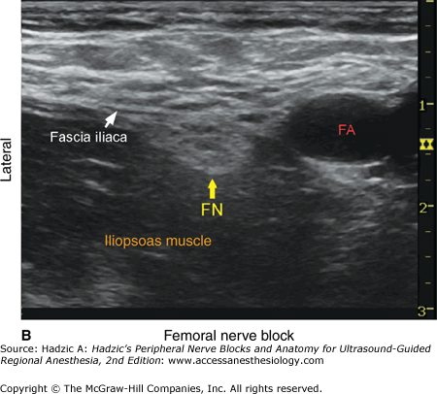
Femoral Block

Slide 35
Saphenous Block
Anterior knee
Medial calf
Medial component of ankle surgery
“quadriceps sparing” – increased ambulation and quad strength compared to femoral nerve block

Slide 36
Saphenous Nerve Block

Slide 37
Popliteal Block (Sciatic Nerve)
Surgery below the knee
Foot & ankle surgery

Slide 38
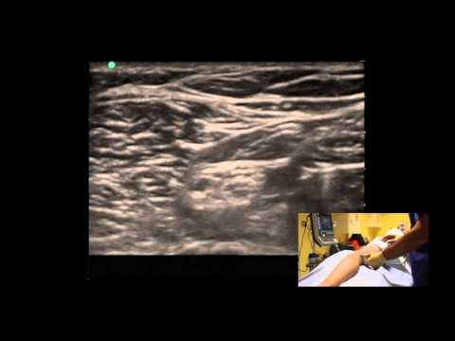
Popliteal block

Slide 39
Nerve Block Risks
Bleeding
Infection
Nerve Injury
Block Failure

Slide 40
Local Anesthetic Selection
Duration
Medium-acting (Mepivacaine, Lidocaine) – 3-8hrs
Long-acting (Ropivacaine, Bupivacaine) acting – 8-18 hrs

Slide 41
Dosing
volume
concentration

Slide 42
Local Anesthetics
Mechanism of action:
Interrupt nerve conduction
Bind to Na channels and block movement of ions
Properties:
Duration – lipid solubility
Speed of onset – pKa (closer to pH, faster the onset)

Slide 43
Post-op Management
Catheter follow-up on a daily basis
Confirm resolution of block
Monitor for complications
Evaluate patient satisfaction

Slide 44
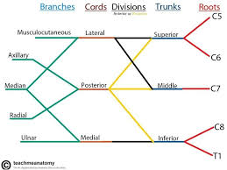
Thank you!

